Slide 1
Simple Machines

Slide 2
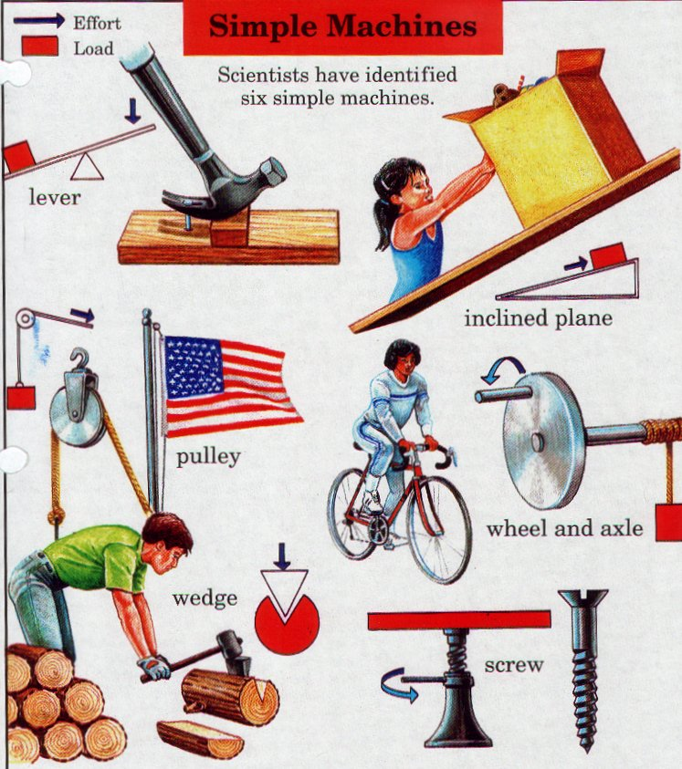
What is a Simple Machine?
A simple machine has few or no moving parts.
Simple machines make work easier

Slide 3
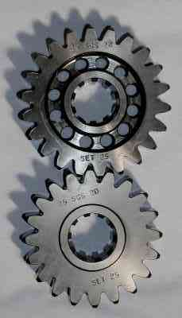
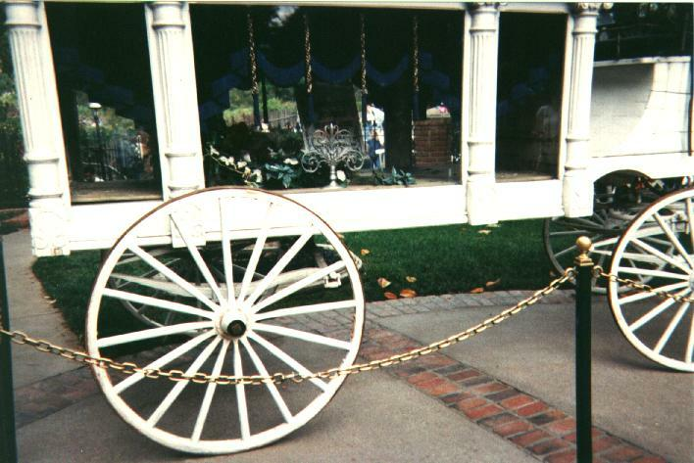
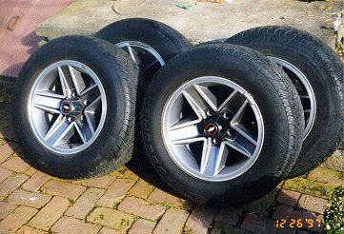
Wheels and Axles
The wheel and axle are a simple machine
The axle is a rod that goes through the wheel which allows the wheel to turn
Gears are a form of wheels and axles

Slide 4
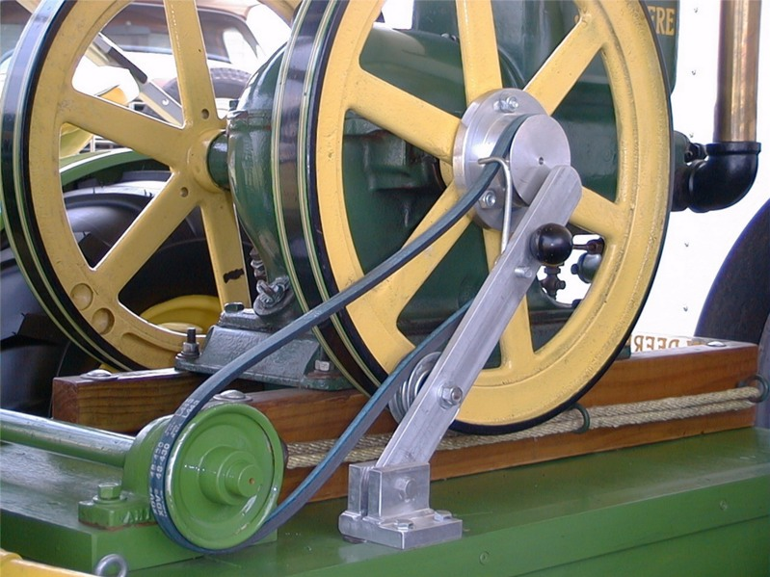
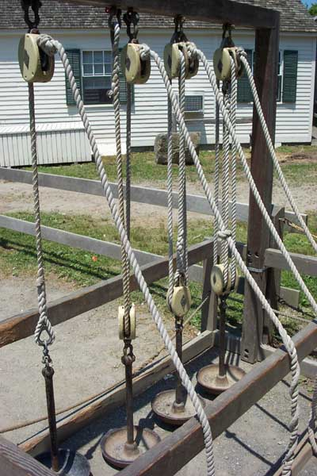
Pulleys
Pulley are wheels and axles with a groove around the outside
A pulley needs a rope, chain or belt around the groove to make it do work

Slide 5
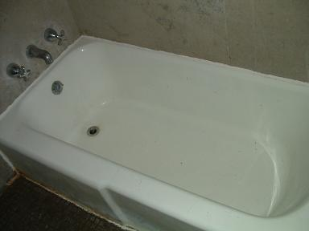
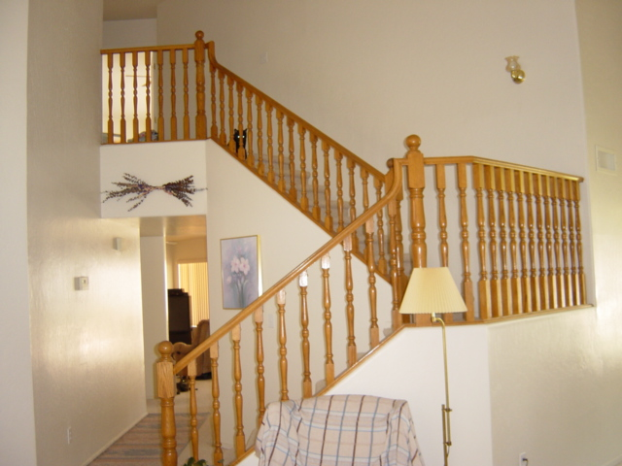
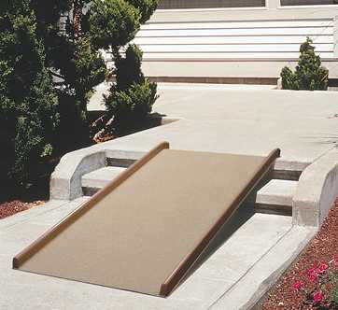
Inclined Planes
An inclined plane is a flat surface that is higher on one end
Inclined planes make the work of moving things easier
Notes:
A sloping surface, such as a ramp. An inclined plane can be used to alter the effort and distance involved in doing work, such as lifting loads. The trade-off is that an object must be moved a longer distance than if it was lifted straight up, but less force is needed.
You can use this machine to move an object to a lower or higher place. Inclined planes make the work of moving things easier. You would need less energy and force to move objects with an inclined plane.

Slide 6
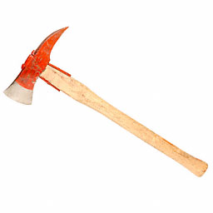
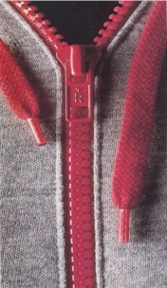
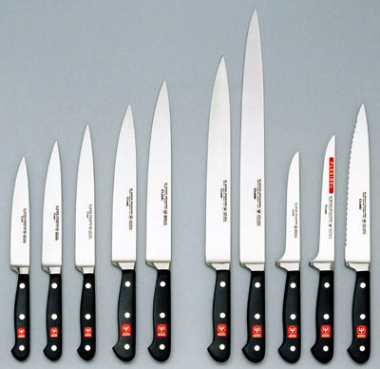
Wedges
Two inclined planes joined back to back.
Wedges are used to split things.

Slide 7
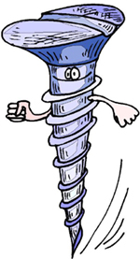
Screws
A screw is an inclined plane wrapped around a shaft or cylinder.
The inclined plane allows the screw to move itself when rotated.

Slide 8
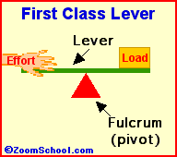
Levers-First Class
In a first class lever the fulcrum is in the middle and the load and effort is on either side
Think of a see-saw

Slide 9
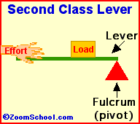
Levers-Second Class
In a second class lever the fulcrum is at the end, with the load in the middle
Think of a wheelbarrow

Slide 10
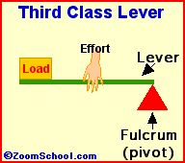
Levers-Third Class
In a third class lever the fulcrum is again at the end, but the effort is in the middle
Think of a pair of tweezers

Slide 11
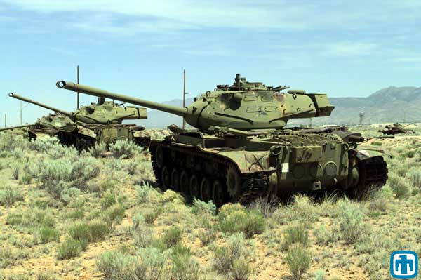
Simple Machines
Simple Machines can be put together in different ways to make complex machinery

